Slide 1
Flutter Introduction
Mohamed Elbaiomy

Slide 2

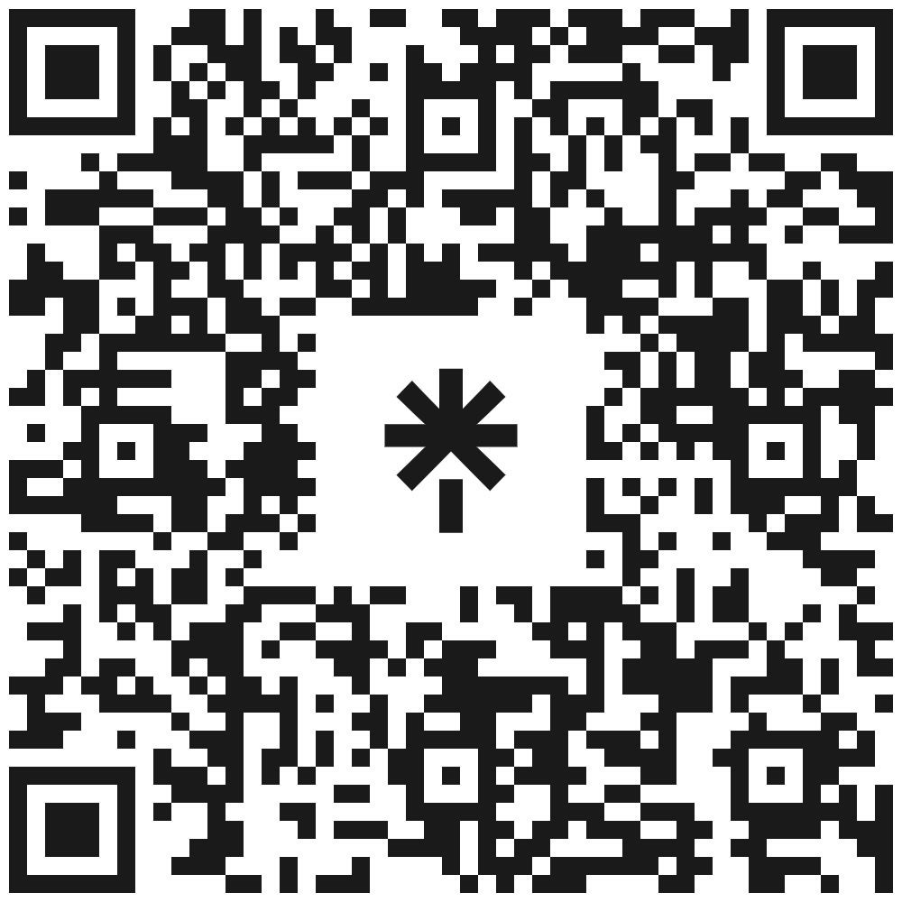
Mohamed Elbaiomy
Flutter Team Lead
ITI Certification
Creativa Benha Ambassador
Head Flutter GDG Benha
Flutter Instructor
two years @ 3C coding school
Certified Flutter developer from ITI
Current Season 2023 - 2024
@ Stemate Benha

Slide 3
BootCamp Roadmap
Day 1
Day 3
Day 5
Day 2
Day 4
Day 6
Flutter Introduction & Layout Widgets
Dart Basics
Calculator
OOP
Business Card
Competition

Slide 4
What is Flutter ?

Slide 5





Slide 6
More than 3 million
More than 1 million
11 app
Flutter Developers Global
App All over the world using Flutter
From Google using Flutter

Slide 7
Why Flutter ?
Simple to learn
1
2
UI development is quick and easy
Growing & Good Documentation
3
4
Close to native Performance

Slide 8

Basic Dart Program
This is a simple dart program that prints Hello World on screen.
Basic Dart Program Explained
void main() is the starting point where the execution of your program begins.
Every program starts with a main function.
The curly braces {} represent the beginning and the ending of a block of code.
print(“Hello World!”); prints Hello World! on screen.
Each code statement must end with a semicolon.

Slide 9
Comments
Comments are the set of statements that are ignored by the dart compiler during program execution. They are used to explain the code so that you or other people can understand it easily.
Advantages Of Comments
You can describe your code.
Other people will understand your code more clearly.
Types Of Comments
Single-Line Comment: For commenting on a single line of code. // Multi-Line Comment: For commenting on multiple lines of code. /* */
Documentation Comment: For generating documentation or reference for a project/software package. ///

Slide 10
What is Variables

Slide 11

Declare Variable in Dart
Variable Types : They are called data types
String: For storing text value. E.g. “John” [Must be in quotes]
int: For storing integer value. E.g. 10, -10, 8555 [Decimal is not included]
double: For storing floating point values. E.g. 10.0, -10.2, 85.698 [Decimal is included]
num: For storing any type of number. E.g. 10, 20.2, -20 [both int and double]
bool: For storing true or false. E.g. true, false [Only stores true or false values]
Rules For Creating Variables In Dart
Variable names are case sensitive, i.e., a and A are different.
A variable name can consist of letters and alphabets.
A variable name cannot start with a number.
Keywords are not allowed to be used as a variable name.
Blank spaces are not allowed in a variable name.
Special characters are not allowed except for the underscore (_) and the dollar ($) sign.

Slide 12
String & Methods
Store text based data like : name , address , complete book

Slide 13
String Methods
01
isEmpty & isNotEmbty
03
Length
Returns true/false if this string is empty or not
Return the length of the string including space and tap
02
to Lower/Upper case
04
trim & trimRight/Left
Convert all characters to lowercase / uppercase
Return the string without any leading and trailing whitespace

Slide 14
String Methods
5
6
7
contains()
indexOf()
replaceAll(text,text)
Return true / false if the character exists
Takes value and Return its index
Replace text with another text
8
9
10
compareTo()
subString(start,end?)
split()
0 when two text are equal , 1 when first > second , -1 second > first
get text from any position
split String by comma , space or letter

Slide 15
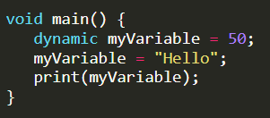
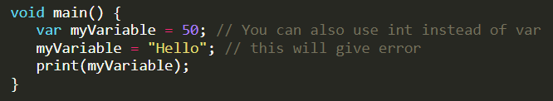
Advanced Data Types
Dynamic & Var
Both of them are used to define variables that can store any type of data, but with a slight difference

Slide 16

Advanced Data Types
Final Vs Const
If you do not want to change the value of a variable, then you can use either final or const in dart.
Const In Dart
If you need to calculate value at compile-time, it is a good idea to choose const over final. A const variable is a compile-time constant. They must be created from data that can be calculated at compile time. 100+1 is valid const expression but const date = DateTime.now(); is not.
Final In Dart
If the value is calculated at runtime, you can choose final for it. For. e.g if you want to calculate date on run time, you can use final date = DateTime.now(); but not const date = DateTime.now();.

Slide 17
Compile Time vs RunTime
CompileTime
RunTime
When you run code in the dart, it will be compiled into the format that the machine can understand
Runtime is the time when your compiled code is started running. It generally occurs after the compile time.
When To Use Const
If you know the value at compile-time, choose const for e.g. const a = 100;.
When To Use Final
If you don’t know the value at compile-time, choose final.
If you want a network request that can’t be changed, choose final.
If you want to get some values from the database, choose final.
If you want to read a local file, choose final.

Slide 18
Arithmetic Operators
Operator Symbol | Operator Name | Description
+ | Addition | For adding two operands
- | Subtraction | For subtracting two operands
* | Multiplication | For multiplying two operands
/ | Division | For dividing two operands and give output in double
~/ | Integer Division | For dividing two operands and give output in integer
% | Modulus | Remainder After Integer Division

Slide 19
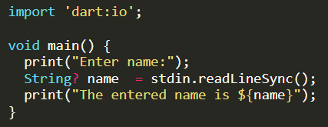
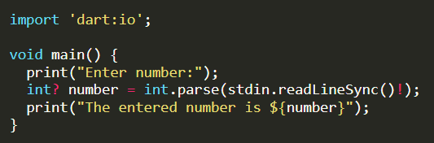
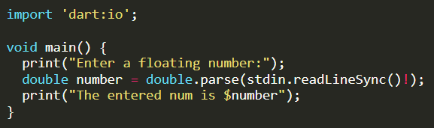
User Input In Dart
Instead of writing hard-coded values, you can give input to the computer. It will make your program more dynamic. You must import the package import 'dart:io'; for user input.

Slide 20
Casting
To string
From String
to from int - to from double
Using .toInt & .toDouble method
Using .parse() method
Using .toString() method
this method takes always string source inside ( )

Slide 21
Conditions

Slide 22
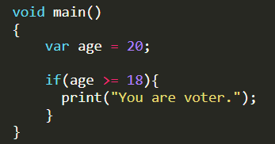
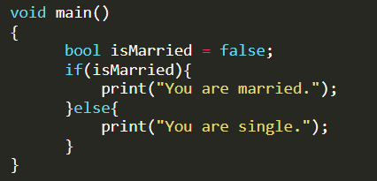
If Condition
The easy and most common way of controlling the flow of a program is through the use of an if statement. If statement allow us to execute a code block when the given condition is true.
If-Else Condition
If the result of the condition is true, then the body of the if-condition is executed. Otherwise, the body of the else-condition is executed.

Slide 23
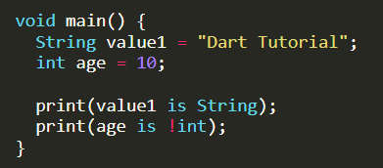
Type test Operator
In Dart, type test operators are useful for checking types at runtime.
Operator Symbol | Operator Name | Description
is | is | Gives boolean value true if the object has a specific type
is! | is not | Gives boolean value false if the object has a specific type

Slide 24

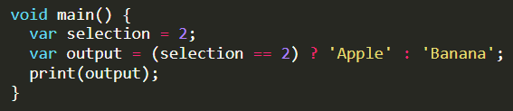
If-Else-If Condition
When you have multiple if conditions, then you can use if-else-if. You can learn more in the example below. When you have more than two conditions, you can use if, else if, else in dart.
Its work is canceled if the condition in the previous case is met
Ternary Operator
The ternary operator is like if-else statement. This is a one-liner replacement for the if-else statement. It is used to write a conditional expression, where based on the result of a boolean condition, one of the two values is selected.

Slide 25
Switch Case
How does switch-case statement work in dart
The expression is evaluated once and compared with each case value.
If expression matches with case value1, the statements of case value1 are executed. Similarly, case value 2 will be executed if the expression matches case value2. If the expression matches the case value3, the statements of case value3 are executed.
If there is no match, default statements are executed.

Slide 26
Lists

Slide 27
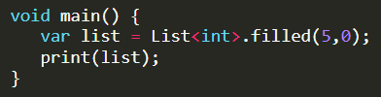
List
If you want to store multiple values in the same variable, you can use List. List in dart is similar to Arrays in other programming languages. E.g. to store the names of multiple students, you can use a List. The List is represented by Square Braces[].
Types Of Lists
Fixed Length List
Growable List [Mostly Used]
Fixed Length List
The fixed-length Lists are defined with the specified length. You cannot change the size at runtime. This will create List of 5 integers with the value 0.

Slide 28
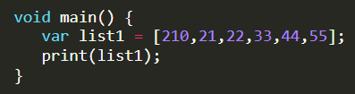
Growable List
A List defined without a specified length is called Growable List. The length of the growable List can be changed in runtime.
Access Item Of List
You can access the List item by index. Remember that the List index always starts with 0.

Slide 29
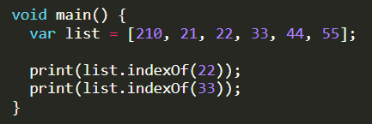
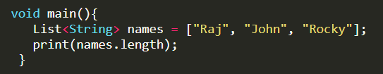
Get Index By Value
Remember that List index starts with 0 and length always starts with 1.
Find The Length Of The List
You can find the length of List by using .length property.

Slide 30
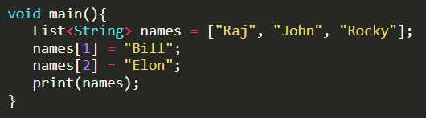
Changing Values Of List
You can also change the value of List. You can do it by listName[index]=value;. For more, see the example below
List Properties In Dart
first: It returns the first element in the List.
last: It returns the last element in the List.
isEmpty: It returns true if the List is empty
isNotEmpty: It returns false if the List is empty.
length: It returns the length of the List.
reversed: It returns a List in reverse order.
single: It is used to check if the List has only one element and returns it.

Slide 31
Adding Item To List
Dart provides four methods to insert the elements into the Lists. These methods are given below.
Method | Description
add() | Add one element at a time and returns the modified List object.
addAll() | Insert the multiple values to the given List, and each value is separated by the commas and enclosed with a square bracket ([]).
insert() | Provides the facility to insert an element at a specified index position.
insertAll() | Insert the multiple value at the specified index position.

Slide 32
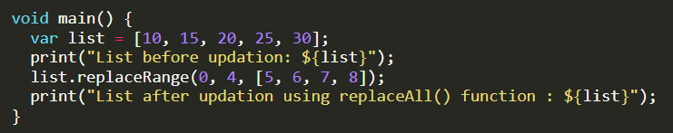
Replace Range Of List
You can also replace the range of the List. For more, see the example below.
Output

Slide 33
Removing List Elements
Method | Description
remove() | Removes one element at a time from the given List.
removeAt() | Removes an element from the specified index position and returns it.
removeLast() | Remove the last element from the given List.
removeRange() | Removes the item within the specified range.

Slide 34
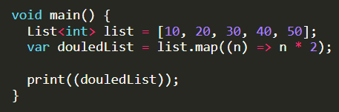
Multiply All Value By 2 Of All List
This example below multiply value of List item by 2.

Slide 35
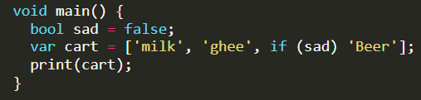
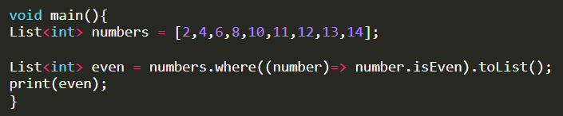
Conditions In List
You can also use conditions in List. Here sad = false so cart doesn’t contain Beer in it.
Where In List Dart
You can use where with List to filter specific items. Here in this example, even numbers are only filtered.

Slide 36
Maps

Slide 37


Slide 38
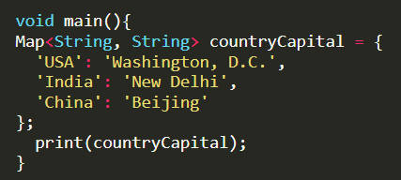
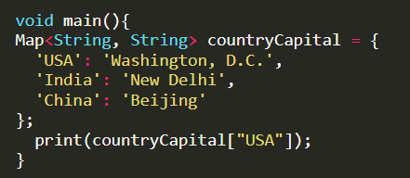
How To Create Map In Dart
Here we are creating a Map for String and String. It means keys and values must be the type of String. You can create a Map of any kind as you like.
Access Value From Key
You can find the value of Map from its key. Here we are printing Washington, D.C. by its key, USA

Slide 39
Map Properties In Dart
Properties | Work
keys | To get all keys.
values | To get all values.
isEmpty | Return true or false.
isNotEmpty | Return true or false.
length | It returns the length of the Map.

Slide 40
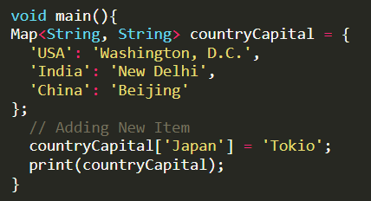
Adding Element To Map
If you want to add an element to the existing Map. Here is the way for you:
also you can add element using .add(value) method.
add multiple elements using
.addAll( [ ] ) method.
Output

Slide 41
Map Methods In Dart
Some useful Map methods in dart.
Properties | Work
keys.toList() | Convert all Maps keys to List.
values.toList() | Convert all Maps values to List.
containsKey(‘key’) | Return true or false.
containsValue(‘value’) | Return true or false.
clear() | Removes all elements from the Map.
removeWhere() | Removes all elements from the Map if condition is valid.

Slide 42
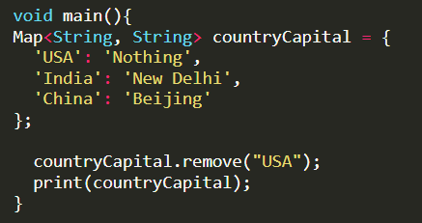
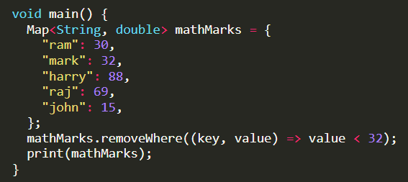
Removing Items From Map
Suppose you want to remove an element of the existing Map. Here is the way for you:
Remove Where In Dart Map
In this example, you will see how to get students whose marks are greater or equal to 32 using where method.

Slide 43
Loops

Slide 44

For Loop
This is the most common type of loop. You can use for loop to run a code block multiple times according to the condition. The syntax of for loop is:
Initialization is executed (one time) before the execution of the code block.
Condition defines the condition for executing the code block.
Increment/Decrement is executed (every time) after the code block has been executed.

Slide 45
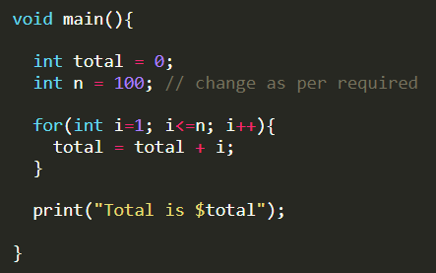
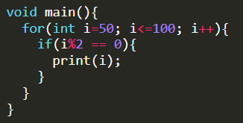
Display Sum of n Natural Numbers Using For Loop
Here, the value of the total is 0 initially. Then, the for loop is iterated from i = 1 to 100. In each iteration, i is added to the total, and the value of i is increased by 1. Result is 1+2+3+….+99+100.
Display Even Numbers Between 50 to 100 Using For Loop

Slide 46
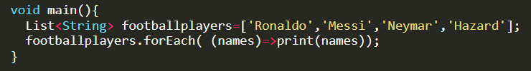
For Each Loop
The for each loop iterates over all list elements or variables. It is useful when you want to loop through list/collection.
Print Each Item Of List Using Foreach
This will print each name of football players :

Slide 47
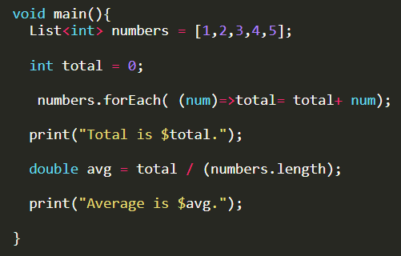
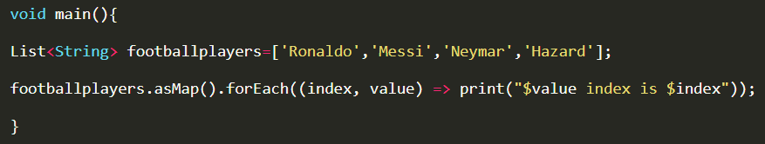
Print Each Total and Average Of Lists
How to Find Index Value Of List
In dart, asMap method converts the list to a map where the keys are the index and values are the element at the index.

Slide 48
While Loop
In while loop, the loop’s body will run until and unless the condition is true. You must write conditions first before statements. This loop checks conditions on every iteration. If the condition is true, the code inside {} is executed, if the condition is false, then the loop stops.
A while loop evaluates the condition inside the parenthesis ().
If the condition is true, the code inside {} is executed.
The condition is re-checked until the condition is false.
When the condition is false, the loop stops.
Do not forget to increase the variable used in the condition. Otherwise, the loop will never end and becomes an infinite loop.

Slide 49
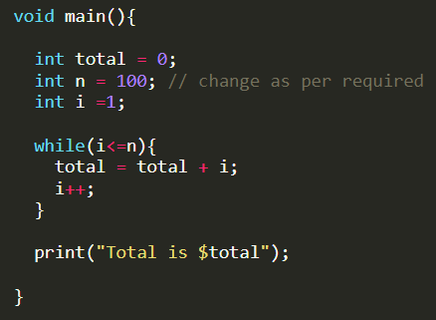
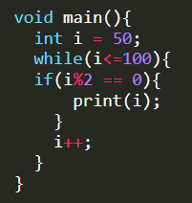
Display Sum of n Natural Numbers Using While Loop
Here, the value of the total is 0 initially. Then, the while loop is iterated from i = 1 to 100. In each iteration, i is added to the total, and the value of i is increased by 1. Result is 1+2+3+….+99+100.
Display Even Numbers Between 50 to 100 Using While Loop

Slide 50
Do While Loop
Do while loop is used to run a block of code multiple times. The loop’s body will be executed first, and then the condition is tested.
First, it runs statements, and finally, the condition is checked.
If the condition is true, the code inside {} is executed.
The condition is re-checked until the condition is false.
When the condition is false, the loop stops.

Slide 51
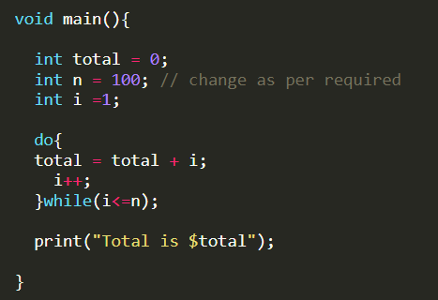
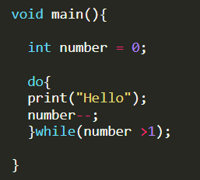

Display Sum of n Natural Numbers Using Do While Loop
When The Condition Is False
Let’s make one condition false and see the demo below. Hello got printed if the condition is false.
Output

Slide 52
BREAK AND CONTINUE

Slide 53
While working on loops, we need to skip some elements or terminate the loop immediately without checking the condition. In such a situation, you can use the break and continue statement.
Break Statement
Sometimes you will need to break out of the loop immediately without checking the condition. You can do this using break statement. The break statement is used to exit a loop. It stops the loop immediately, and the program’s control moves outside the loop
Continue Statement
Sometimes you will need to skip an iteration for a specific condition. You can do this utilizing continue statement. The continue statement skips the current iteration of a loop. It will bypass the statement of the loop. It does not terminate the loop but rather continues with the next iteration

Slide 54
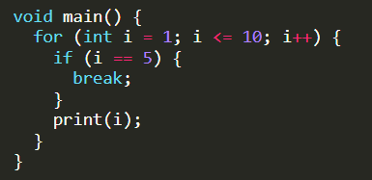

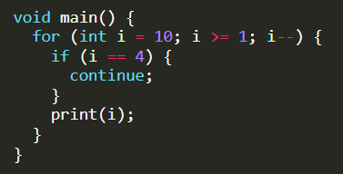

Break In Dart For Loop
Here, the loop condition is true until the value of i is less than or equal to 10. However, the break says to go outside the loop when the value of i becomes 5.
Continue In For Loop Dart
Here, the loop condition is true until the value of i is more than or equal to 1. However, the continue says to go to the next iteration of the loop when the value of i becomes 4.

Slide 55
Functions

Slide 56

Functions are the block of code that performs a specific task. They are created when some statements are repeatedly occurring in the program. The function helps reusability of the code in the program.
Function Advantages
Avoid Code Repetition
Easy to divide the complex program into smaller parts
Helps to write a clean code
Return type: It tells you the function output type. It can be void, String, int, double, etc. If the function doesn’t return anything, you can use void as the return type.
Function Name: You can name functions by almost any name. Always follow a lowerCamelCase naming convention like void printName().
Parameters: Parameters are the input to the function, which you can write inside the bracket (). Always follow a lowerCamelCase naming convention for your function parameter.

Slide 57
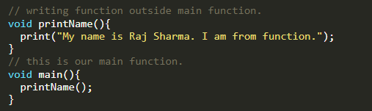
Function That Prints Name
This is a simple program that prints name using function. The name of function is printName().
output

Slide 58
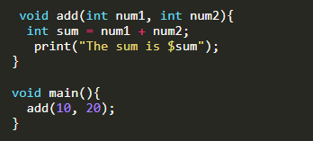

Function To Find Sum of Two Numbers
This function finds the sum of two numbers. Here, the function accepts two parameters.
i.e., num1 and num2, and the return type is void.
output

Slide 59
Key Points
In dart function are also objects.
You should follow the lowerCamelCase naming convention while naming function.
You should follow the lowerCamelCase naming convention while naming function parameters.
About lowerCamelCase
Name should start with lower-case, and every second word’s first letter will be upper-case like num1, fullName, isMarried, etc. Technically, this naming convention is called lowerCamelCase.

Slide 60
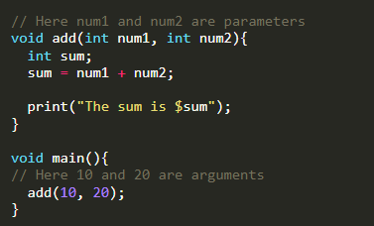
Function Paramaters Vs Arguments
Many programmers are often confused about parameters and arguments. Let’s have a look at this example.
Here in add(int num1, int num2), num1 and num2 are parameters and in add(10, 20), 10 and 20 are arguments.
Parameter is the name and data type you define as an input for your function.
Argument is the actual value that you passed in.

Slide 61
Types Of Function
Functions are the block of code that performs a specific task. Here are different types of functions:
No Parameter And No Return Type
Parameter And No Return Type
No Parameter And Return Type
Parameter And Return Type
Function With No Parameter And No Return Type
In this function, you do not pass any parameter and expect no return type. Here is an example of it:

Slide 62
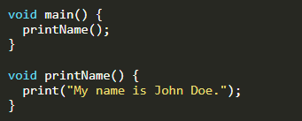
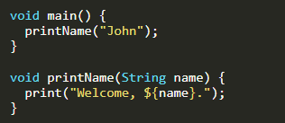
No Parameter & No Return Type
Here printName() is a function which prints name on screen.
In this program, printName() is the function which has keyword void. It means it has no return type, and the empty pair of parentheses implies that there is no parameter that is passed to the function.
Function With Parameter And No Return Type
In this function, you do pass the parameter and expect no return type. Here is an example of it:
In this program, printName(String name) is the function which has keyword void. It means it has no return type, and the pair of parentheses is not empty but this time that suggests it to accept an parameter.

Slide 63
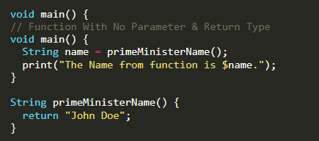
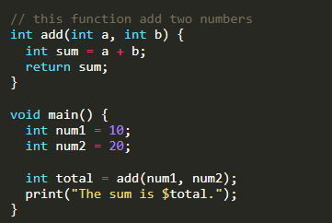
Function With No Parameter And Return Type
In this function, you do not pass any parameter but expect return type. Here is an example of it:
In this program, primeMinisterName() is the function which has String keyword before function name, means it return String value, and the empty pair of parentheses suggests that there is no parameter that is passed to the function.
Function With Parameter And Return Type
In this function, you do pass the parameter and also expect return type. Here is an example of it:
In this program, int add(int a, int b) is the function with int as the return type, and the pair of parenthesis has two parameters, i.e., a and b.

Slide 64
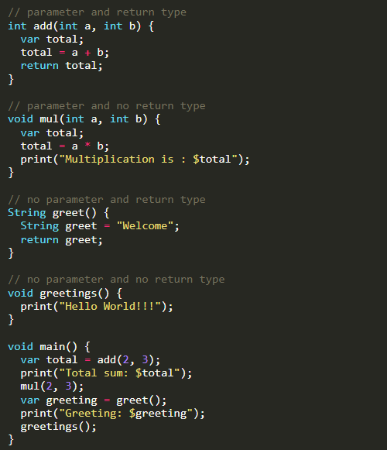

Complete Example
Here is the program, which includes all types of functions we studied earlier.
output

Slide 65
Function Parameter

Slide 66

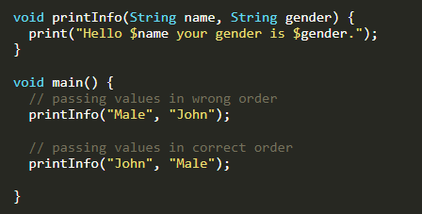

The parameter is the process of passing values to the function. The values passed to the function must match the number of parameters defined. A function can have any number of parameters.
Positional Parameter In Dart
In positional parameters, you must supply the arguments in the same order as you defined on parameters when you wrote the function. If you call the function with the parameter in the wrong order, you will get the wrong result.
In the example below, the function printInfo takes two parameters. You must pass the person’s name and gender in the same order. If you pass values in the wrong order, you will get the wrong result.
output

Slide 67
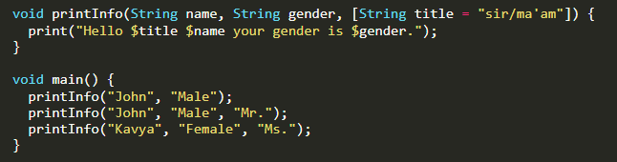

Providing Default Value On Positional Parameter
In the example below, function printInfo takes two positional parameters and one optional parameter. The title parameter is optional here. If the user doesn’t pass the title, it will automatically set the title value to sir/ma’am.
output

Slide 68
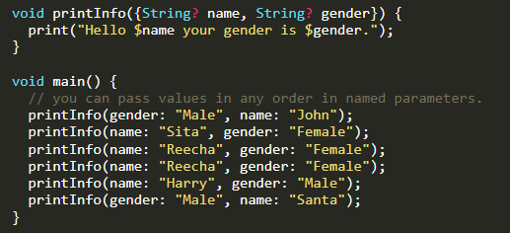
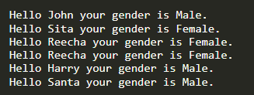
Named Parameter In Dart
Dart allows you to use named parameters to clarify the parameter’s meaning in function calls. Curly braces {} are used to specify named parameters.
In the example below, function printInfo takes two named parameters. You can pass value in any order. You will learn about ? in null safety section.
output

Slide 69
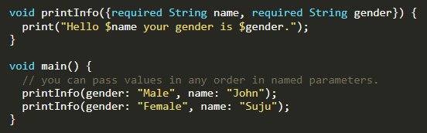

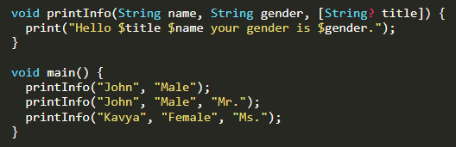

Use Of Required In Named Parameter
In the example below, function printInfo takes two named parameters. You can see a required keyword, which means you must pass the person’s name and gender. If you don’t pass it, it won’t work.
output
Optional Parameter In Dart
Dart allows you to use optional parameters to make the parameter optional in function calls. use Square braces []
Use Of Optional Parameter
In the example below, function printInfo takes two positional parameters and one optional parameter. First, you must pass the person’s name and gender. The title parameter is optional here. Writing [String? title] makes title optional.
output

Slide 70
Anonymous Function

Slide 71

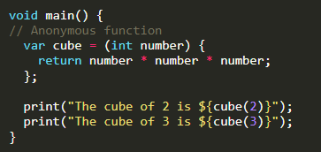

Anonymous Function In Dart
You already saw function like main(), add(), etc. These are the named functions, which means they have a certain name.
But not every function needs a name. If you remove the return type and the function name, the function is called anonymous function.
In this example, you will learn to find the cube of a number using an anonymous function.
output

Slide 72
Arrow Function in Dart
Dart has a special syntax for the function body, which is only one line. The arrow function is represented by => symbol. It is a shorthand syntax for any function that has only one expression.

Slide 73



Simple Interest Without Arrow Function
This program finds simple interest without using the arrow function.
output
Simple Interest With Arrow Function
This program finds simple interest using the arrow function.
output

Slide 74


Simple Calculation Using Arrow Function
This program finds the sum, difference, multiplication, and division of two numbers using the arrow function.
output

Slide 75
Scope in Dart
The scope is a concept that refers to where values can be accessed or referenced. Dart uses curly braces {} to determine the scope of variables. If you define a variable inside curly braces, you can’t use it outside the curly braces.

Slide 76


Method Scope
If you created variables inside the method, you can use them inside the method block but not outside the method block.
In this program, text is a String type where you can access and print method only inside the main function but not outside the main function.
Global Scope
You can define a variable in the global scope to use the variable anywhere in your program.
In this program, the variable named global is a top-level variable; you can access it anywhere in the program.
Note: Define your variable as much as close Local as you can. It makes your code clean and prevents you from using or changing them where you shouldn’t.

